Slide 1
Utilizing Holden Principles for an Executive Value Proposition Industrial/Heavy Equipment Industry Customer Service Experience Example
Brad Rud
April 2011

Slide 2


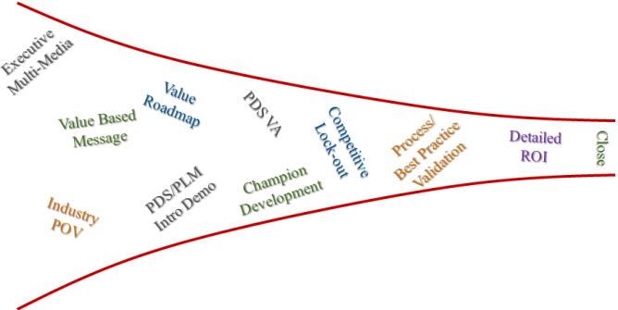
Value Presentation Key Objectives
Concisely Communicate the Value Proposition
Challenges, Value, Solution
Balance of Qualitative & Quantitative Evidence
“Simplicity is the ultimate sophistication” – Leonardo da Vinci
Achieve Presentation “Flow”
Leverage updated PTC Branding
Easy to follow and understand
Adhere to effective KISS Presentation methodology
Aligns with Holden Principles
Critical Business Issues, Business Impact, Area of Improvement, Credibility
Earn the Right to Engage Strategically before Technically
Establish credibility
Engage in exploratory fashion
Enable focused technical execution
E
M
O

Slide 3
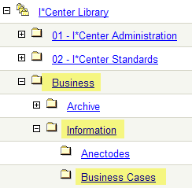
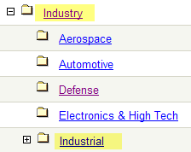
Where can I find the Holden Value Template?
I*Center Library
Holden Value Template Presentation
Business | Information | Business Cases
Industrial Examples (SIS & QLM)
Industry | Industrial

Slide 4





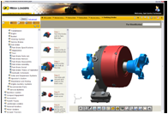



Customer Initiative enabled by PTC Solution
Customer Challenges
Characterize key challenges
Business Challenges
Outline key challenge that hinder our customers from achieving business objectives
Value Opportunities
Economic Value, Competitive Value, Strategic Value, Return on Investment
PTC Solutions
Solutions, Processes, Best Practices, References & Demonstrations

Slide 5



Customer Challenges
Business Challenges
Value Opportunities
PTC Solutions
“Customer Quote” capturing the essence of the challenges
Example 1
Example 2
Example 3
Example 4
Example 5
Roadmap of the concepts to be covered

Slide 6
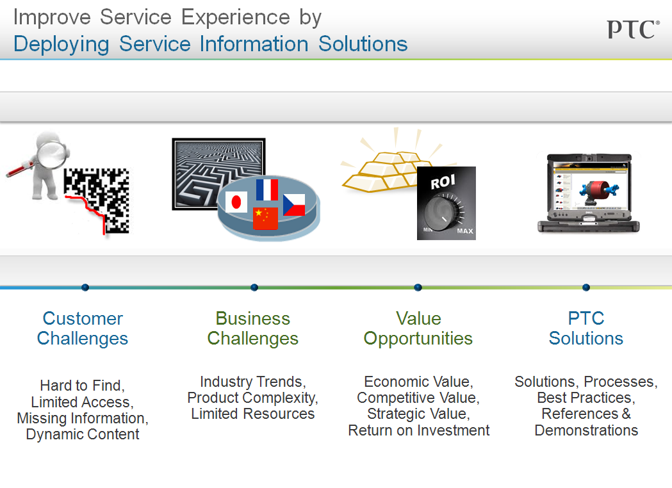
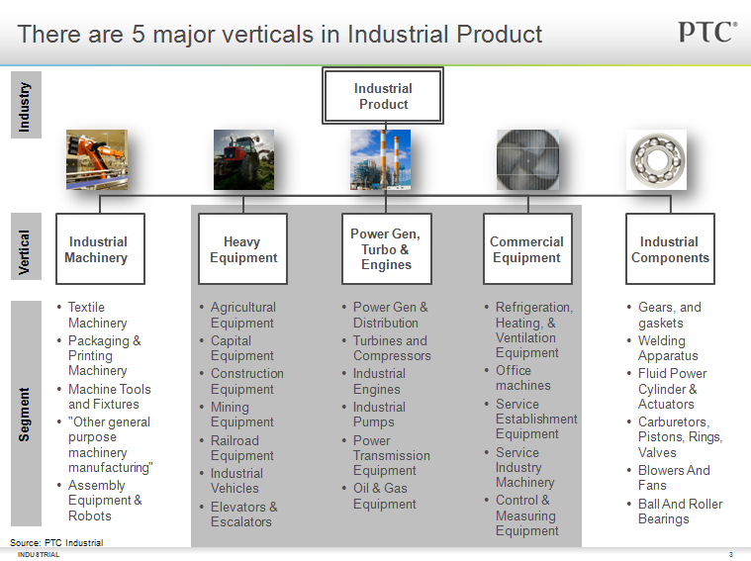
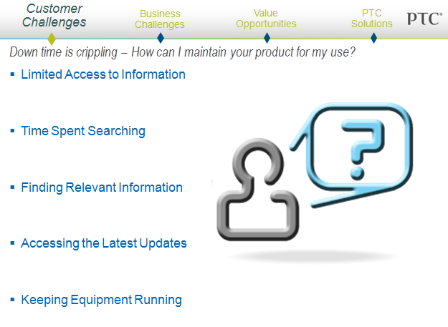
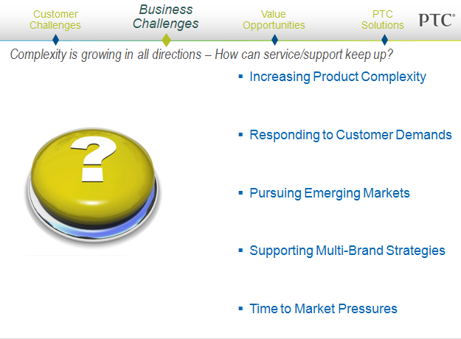
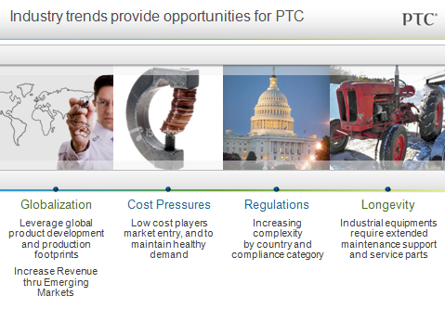
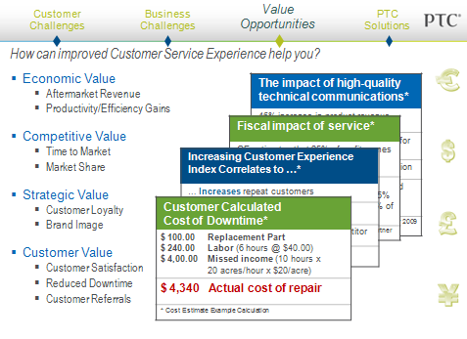
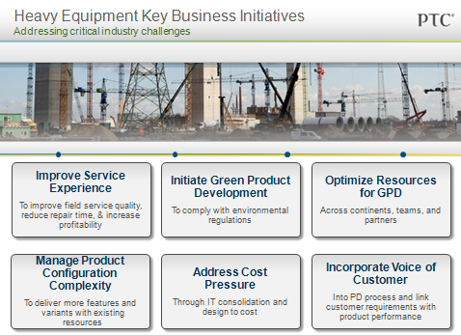
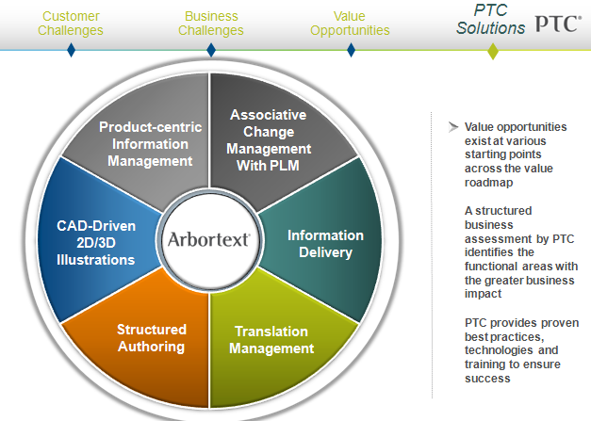
Holden Value Based Presentation Template
4 Holden Topics in a Value Statement
Vertical Segments Trends & Initiatives
1) Critical Issues
Challenges, Goals, Initiatives of highest importance to customer
2) Business Impact
Qualitative and Quantitative Value Opportunities
4) Credibility
References, Demos, Process & Best Practices
3) Improvement Area
High level description of proposed solution

Slide 7
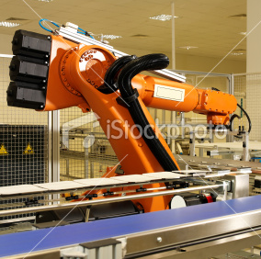




There are 5 major verticals in Industrial Product
Industrial
Product
Industry
Vertical
Industrial
Machinery
Heavy
Equipment
Power Gen,
Turbo &
Engines
Commercial
Equipment
Industrial
Components
Textile Machinery
Packaging & Printing Machinery
Machine Tools and Fixtures
"Other general purpose machinery manufacturing"
Assembly Equipment & Robots
Agricultural Equipment
Capital Equipment
Construction Equipment
Mining Equipment
Railroad Equipment
Industrial Vehicles
Elevators & Escalators
Power Gen & Distribution
Turbines and Compressors
Industrial Engines
Industrial Pumps
Power Transmission Equipment
Oil & Gas Equipment
Refrigeration, Heating, & Ventilation Equipment
Office machines
Service Establishment Equipment
Service Industry Machinery
Control & Measuring Equipment
Gears, and gaskets
Welding Apparatus
Fluid Power Cylinder & Actuators
Carburetors, Pistons, Rings, Valves
Blowers And Fans
Ball And Roller Bearings
Segment
Source: PTC Industrial

Slide 8



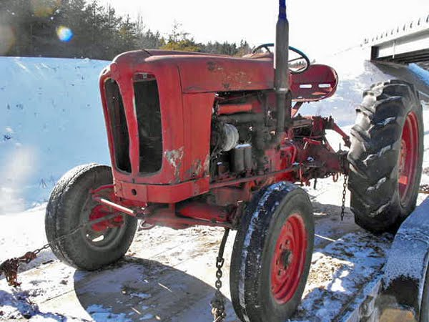
Industry Trends Drive Business Initiatives
Globalization
Leverage global product development and production footprints
Increase Revenue thru Emerging Markets
Cost Pressures
Low cost players market entry, and to maintain healthy demand
Regulations
Increasing complexity by country and compliance category
Longevity
Industrial equipments require extended maintenance support and service parts
Notes:
As documented by Giga in a study entitled “Total Economic Impact of Collaborative Product
Development,” the benefits of using an enterprise PLM solution can be:
Reduce product development lifecycle time by 40%
Accelerates information sharing between design engineers with robust collaboration
spaces aggregating required information, project timelines and activity assignments.
• Reduce number of process errors by 50%
Ensures that participants are using the most up-to-date and accurate product data.
• Reduce product development travel expenses by 65%
Powers collaboration spaces that aggregate all required information and include
discussion forums and meeting spaces to conduct design reviews and other virtual
meetings.
• Reduce engineering change order processing time by 85%
Delivers automated, standards-based engineering change processes (spanning request,
analysis, and notification) containing supporting data, assignments and activity tracking
for monitoring.
• Reduce time to market by 40%
Bridges the communication and exchange of product data between design and
manufacturing to meet time-to-market requirements.

Slide 9

Key Business Initiatives
Improve Service Experience
To improve field service quality, reduce repair time, & increase profitability
Initiate Green Product Development
To comply with environmental regulations
Optimize Resources for GPD
Across continents, teams, and partners
Manage Product Configuration Complexity
To deliver more features and variants with existing resources
Address Cost Pressure
Through IT consolidation and design to cost
Incorporate Voice of Customer
Into PD process and link customer requirements with product performance

Slide 10
Improve Customer Service Experience by Deploying Service Information Solutions
Customer Challenges
Hard to Find, Limited Access, Missing Information, Dynamic Content
Business Challenges
Industry Trends, Product Complexity, Limited Resources
Value Opportunities
Economic Value, Competitive Value, Strategic Value, Return on Investment
PTC Solutions
Solutions, Processes, Best Practices, References & Demonstrations

Slide 11
Customer Challenges
Business Challenges
Value Opportunities
PTC Solutions
Down time is crippling – How can I maintain “your product” for “my use”?
Holden Topic 1: Critical Issues
Limited Access to Information
Time Spent Searching
Finding Relevant Information
Accessing Updates
Keeping Equipment Running

Slide 12

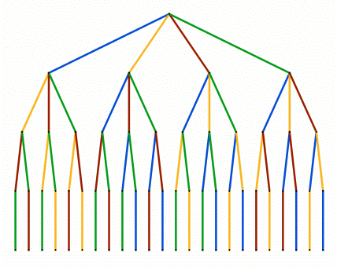


Customer Challenges
Business Challenges
Value Opportunities
PTC Solutions
Complexity is growing in all directions – How can service/support keep up?
Holden Topic 1: Critical Issues
Increasing Product Complexity
Responding to Customer Demands
Pursuing Emerging Markets
Supporting Multi-Brand Strategies
Time to Market Pressures

Slide 13






Challenges of Poor, Inaccurate Service Information
Customer Challenges
Business Challenges
Value Opportunities
PTC Solutions
Holden Topic 2: Business Impact
Assembly & Shipment
Training & eLearning
Parts
Identification & Sales
Operation,
Maintenance & Repair
Customer
Support &
Self-Help
Liability and
Compliance
17 week documentation cycle risks new product introduction
Ad-hoc, disparate service information system puts approximately $60M spare parts revenue at risk/yr
60% of inbound calls to Technical Support is from customers looking for product information they already have
Equipment downtime results in $1M per day of lost revenue
Localization costs soar to 60% documentation budget, exceeding $800K
Up to 30% of billable service resolution time is spent looking for information
If Safety Reports are not current – the nuclear power plant shuts down
Shipments delayed by missing documentation resulted in
$10M in lost revenues
Our technical illustrations aren’t in line with the actual products and create liabilities in the field
New emission requirements render our existing technical and service information obsolete
13
© 2010 PTC
Notes:
Let’s evaluate various impacts of poor quality service information throughout typical scenarios that we’ve witnessed throughout the industry –
At the point of new product delivery – if supporting documentation such as assembly instructions and operator manuals are not available because of printing and translation schedules – new products don’t ship, revenue targets are missed and ultimately customer adoption cycles are slowed and could result in permanent missed market penetration.
17 week cycles = Komatsu; localization = Ingersoll rand Club Car
<CLICK>
Once in the market – your customers or support organizations – are responsible for the training and management of equipment utilization. If information is poorly represented – maybe inaccurate text or graphics, or not available in a specific language – then your are facing increased errors and delayed equipment productivity.
Technical illustration liabilities = Schneider Electric; localization costs = Komatsu
<CLICK>
A tremendous opportunity for most product support and service organizations is the ability to correctly identify and supply spare parts to increase revenues – if your process has a high rate of “misdiagnosis” – then you’re likely cycling spares through your processes unnecessarily – burdening the spare parts operations and risking revenues –
Ad-hoc systems risk future growth and revenue = CAT;
<CLICK>
The most worrisome aspect for most organizations, whether it’s your own field service organization or your customer’s equipment management, is the lost time, profits and revenues related to inefficient services tasks in the field. Not only are the costs high in terms of skilled technician productivity but the lost revenues/productivity of the equipment.
$1M downtime = Vetco Gray energy; 30% billable time lost to “unfound” info = Nikon Precision EHT
<CLICK>
Many organizations are working to increased the productivity of their call centers related to call management, customer knowledge, etc. but it’s actually an extremely time consuming task to support inbound calls from your extended support organization and your customers who are seeking information for procedures – information that they already have available in some method – but information that is too difficult to find
60% of inbound calls looking for information already available = CAT;
<CLICK>
Finally, equipment and services that support highly regulated industries suffer the further burden of sustaining compliance and safety information requirements in their everyday processes. If this information is not accessible and up to date, that equipment is forced offline resulting in lost revenues and potential penalties for non compliance.
--new emissions = Komtasu; safety reports, plant shut down = Electrice de France
<CLICK>
Unfortunately, although supporting the same products – these downstream processes are disconnected and depend on disparate sources of information to support their tasks – resulting in inconsistent and unpredictable product performance.

Slide 14




Customer Challenges
Business Challenges
Value Opportunities
PTC Solutions
How can improved Customer Service Experience help you?
Economic Value
Aftermarket Revenue
Productivity/Efficiency
Translation Costs
Warranty Expenses
Competitive Value
Time to Market
Market Share
Strategic Value
Customer Loyalty
Brand Image
Customer Value
Customer Satisfaction
Reduced Downtime
Customer Referrals
The impact of high-quality technical communications*
10% increase in spare parts & aftermarket business
20% increase in service documentation productivity
35% decrease in translation management costs
30% decrease is service calls that require multiple trips
*Sample PTC Customer Metrics
Fiscal impact of service*
GE estimates that 25% of profit comes from product-related services and $35B in revenue
Industry studies state that services organizations contribute between 25% and 47% of revenues and up to 50% of profit
*(1) Boston Consulting Group, Aberdeen and Gartner
Higher Customer Experience Index Correlates to …*
Increased repeat customers
Increased customer referrals
Reduced loss of business to a competitor
*Forrester Research – The Business Impact Of Customer Experience, 2010
Customer Calculated Cost of Downtime*
$ 100.00 Replacement Part $ 240.00 Labor (6 hours @ $40.00) $ 4,00.00 Missed income (10 hours x 20 acres/hour x $20/acre)
$ 4,340 Actual cost of repair
* Cost Estimate Example Calculation

Slide 15



Customer Challenges
Business Challenges
Value Opportunities
PTC Solutions
Holden Topic 2: Business Impact
Value throughout the Service Ecosystem
Improve content creation processes / automation
Reduce costs
Improve cycle times
Publish real-time, targeted multi-channel info
Improve parts accuracy & revenues
Reduce resolution cycles
Improve customer loyalty
Dealer &
Customer
Author /
Illustrator
Deliver interactive, product-centric service procedures on demand
Improve 1st time fix rates, reduce errors
Increase worker effectiveness
Enhance customer satisfaction
Increase profits
Supply all-in-one information resource for downstream users
Accelerate product adoption
Reduce operating costs
Maintain &
Repair
Support
& Training
Notes:
Traditionally, companies measure the success of their technical documentation or publishing teams based on their ability to reduce costs and/or to meet information cycle times to meet shipping requirements.
CLICK
However, it’s a much broader business opportunity to understand and measure the impact of technical communications to your downstream users – whether it’s in aftermarket services, spare parts, training, your dealer network and even your customers.
It’s the influence that your product, support and technical information has on the overall product performance, the customer’s satisfaction and the ability to generate better revenues and profits that is the real value behind Service Information.

Slide 16
Customer Challenges
Business Challenges
Value Opportunities
PTC Solutions
Sample Adoption Roadmap Results (Value/ROI Calculation)
Holden Topic 2: Business Impact

Slide 17

Customer Challenges
Business Challenges
Value Opportunities
PTC Solutions
Holden Topic 3: Improvement Area
PTC Has Solved the Fragmentation Problem
3D
2D
Content Reuse
Automate
Processes
Manage
Dynamic
Docs
Technical
Illustrations
Schematics
Product-centric Information
Mgt.
Author Offline
PLM
Just-in-
Time
Interactive,
Real-time
Associative
Product Data
Interactive
Delivery
Product-centric
Legacy
Dynamic
Publishing
Multi-
Channel
Translation Management
XML
Structured
Authoring
Automate
Translation
Packages
Automate
Publishing
S1000D
Profile,
Aggregate
& Format
Manage
Master
Topics
Upload &
Associate
Translations
DITA
Notes:
As mentioned, Arbortext is the only fully integrated solution to provide all aspects of your technical (service information) communications needs. Depending on your current environment, Arbortext software works with existing applications such as ERP, PLM, etc to create, illustrate, manage, associate, localize and deliver information in the context and media desired.
(CLICK)
It’s the mature, interoperable capabilities of PTC’s Arbortext (including other PTC products such as Windchill) that delivers a comprehensive footprint of value throughout your communications processes.
When evaluating your technology options and long-term supportability, it’s imperative to consider how alternative, disparate technical publishing solutions will can support your products throughout their lifecycle and maintain the associativity with the product development cycle and your downstream processes.
And based on your priorities, PTC can provide a methodology and process roadmap to achieve short-term and long-term success. CLICK

Slide 18

Customer Challenges
Business Challenges
Value Opportunities
PTC Solutions
Holden Topic 3: Improvement Area
Associative
Change
Management
With PLM
Product-centric
Information
Management
Value opportunities exist at various starting points across the value roadmap
A structured business assessment by PTC identifies the functional areas with the greater business impact
PTC provides proven best practices, technologies and training to ensure success
Technical
Illustrations
Product-centric Information
Mgt.
PLM
CAD-Driven
2D/3D
Illustrations
Information
Delivery
Interactive
Delivery
Dynamic
Publishing
Translation Management
Structured
Authoring
Structured
Authoring
Translation
Management

Slide 19



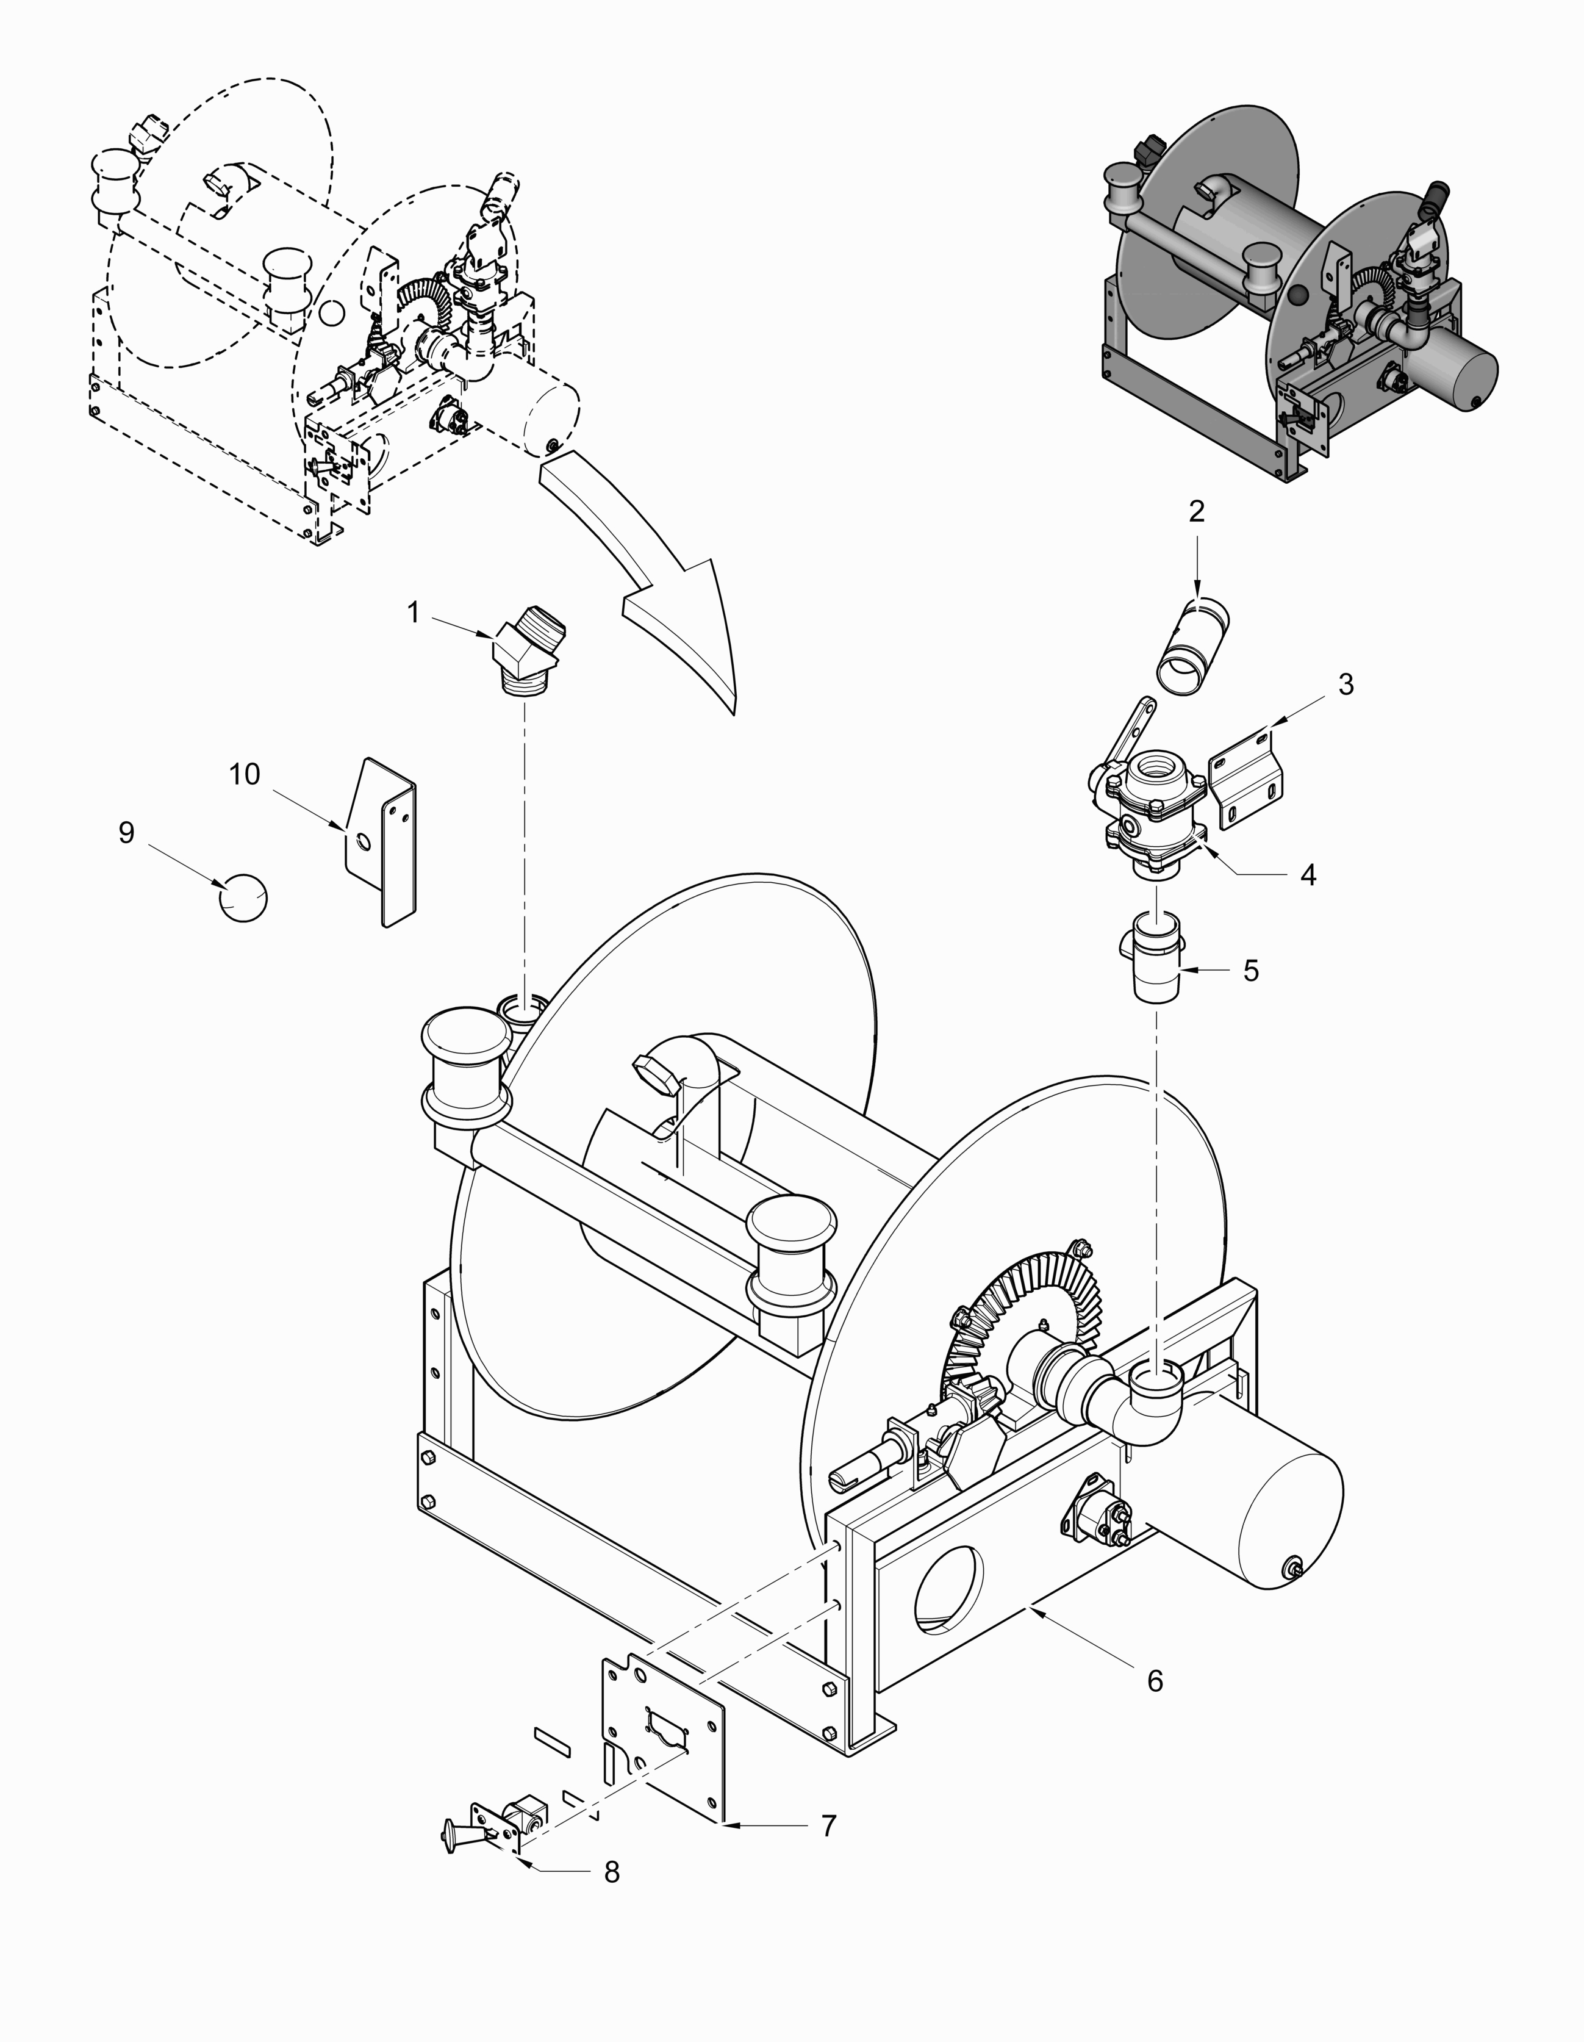

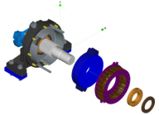
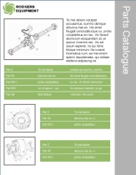
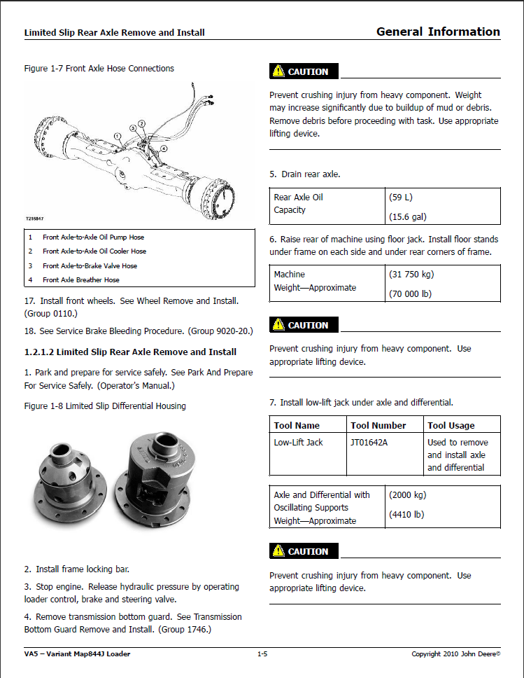
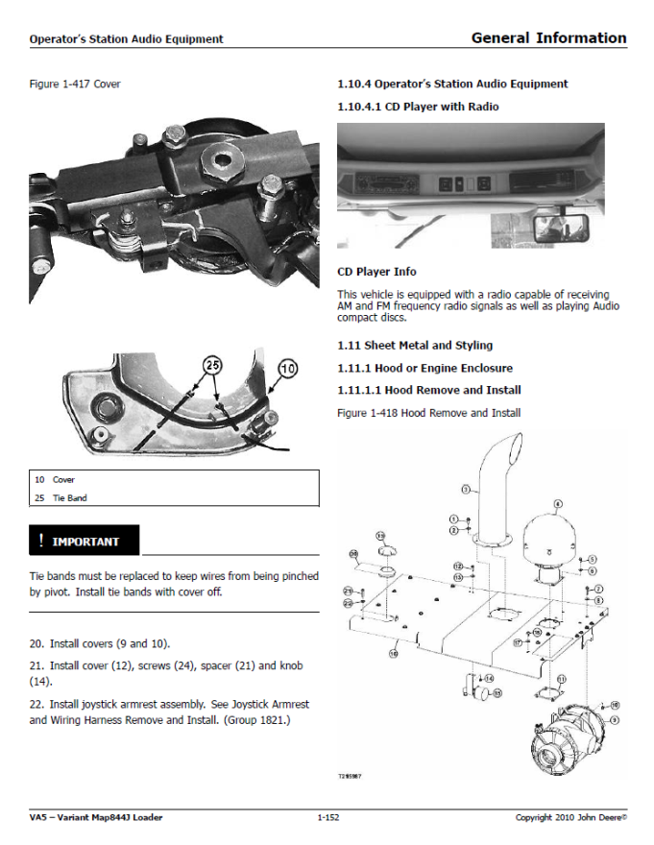
Customer Challenges
Business Challenges
Value Opportunities
PTC Solutions
PTC improves your Business with Best in Class Products and Proven Best Practices
Holden Topic 3: Improvement Area
Technology
Processes
Best Practices
CAD-based 2D and 3D Technical Illustrations
Reducing Costs, Improving Quality of Technical Publications
Product Support Analysis & Planning
Technical Information Creation & Delivery
Performance Analysis & Feedback
Optimizing Translation Management
Associative Product Information & Change Management
Interactive Information Delivery

Slide 20



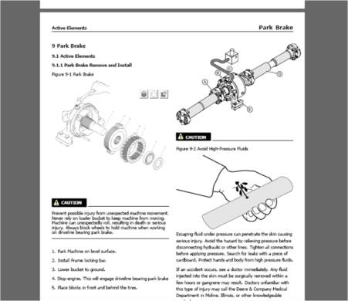

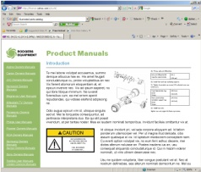

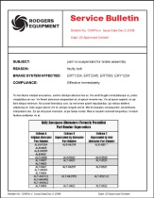

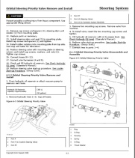
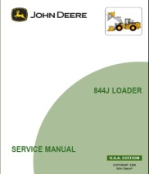


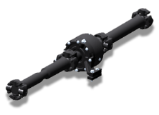
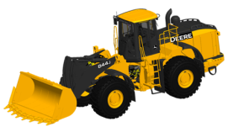
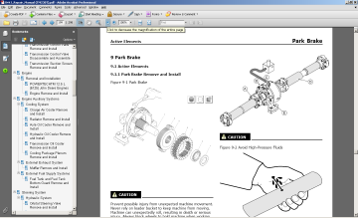
Customer Challenges
Business Challenges
Value Opportunities
PTC Solutions
Holden Topic 3: Improvement Area
Intelligent, All-in-One Service Information
ERP
Brake Systems
Illustrations
Main
Operating Procedures
Parking
Service Procedures
General Info
Spare Parts List (sBOM)
Intelligent
Service Information
CRM
Product-centric
Information
ECM
Real-time
Product Data
LMS

Slide 21





















































Customer Challenges
Business Challenges
Value Opportunities
PTC Solutions
Holden Topic 4: Credibility
PTC Service Information Solutions Customers
AEROSPACE/ DEFENSE
HIGH TECH /
ELECTRONICS
INDUSTRIAL EQUIPMENT
GLOBAL LEADERS
AUTOMOTIVE
Notes:
PTC holds… title
PTC’s customers include some of the most recognized brands across broad industries

Slide 22

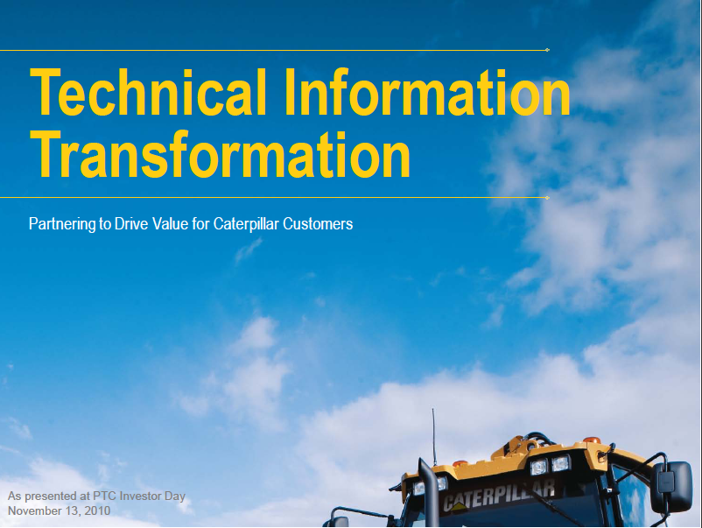
Customer Challenges
Business Challenges
Value Opportunities
PTC Solutions
Sample Case Study: Showing how existing customer achieve value
Holden Topic 4:
Credibility
Internal Only

Slide 23

Customer Challenges
Business Challenges
Value Opportunities
PTC Solutions
Holden Topic 4:
Credibility
“Komatsu estimates that it can save $900,000 annually by reducing its direct and indirect costs of localization, automating its processes and communication with outsourced agencies, and consolidating information shared globally across its business groups.”
Sean Smither, Manager, Service Material, Komatsu America Corp
Notes:
Komatsu America has established a dynamic publishing system that will allow it to repurpose engineering source data to create technical publications and automate the delivery of product information to the field.
Komatsu estimates that it can save $900,000 annually by reducing its direct and indirect costs of localization, automating its processes and communication with outsourced agencies, and consolidating information shared globally across its business groups.

Slide 24

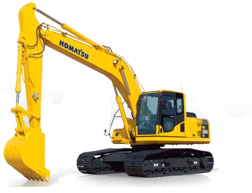
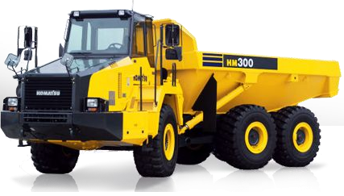
Customer Challenges
Business Challenges
Value Opportunities
PTC Solutions
“Komatsu estimates that it can save $900,000 annually by reducing its direct and indirect costs of localization, automating its processes and communication with outsourced agencies, and consolidating information shared globally across its business groups.”
Sean Smither, Manager, Service Material, Komatsu America Corp
Holden Topic 4:
Credibility
Business Initiative
Improvement Opportunities
Reduce Translation Cost by 56%
Eliminate Illustration Outsourcing
Improve productivity by 20% through re-use, automation and authoring efficiency gains
Solution
Technical Information Creation & Delivery
Notes:
Komatsu America has established a dynamic publishing system that will allow it to repurpose engineering source data to create technical publications and automate the delivery of product information to the field.
Komatsu estimates that it can save $900,000 annually by reducing its direct and indirect costs of localization, automating its processes and communication with outsourced agencies, and consolidating information shared globally across its business groups.

